Slide 1
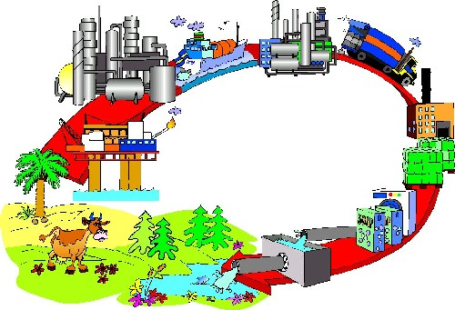
Economic Input-Output Life Cycle Assessment (EIO-LCA)
Environmental LCA PSE 476/WPS 576
Fall 2014
Neethi Rajagopalan and Richard Venditti
Department of Forest Biomaterials
Notes:
Today we are going to talk about a different method used to conduct life cycle assessment called economic input output life cycle assessment. The format of this class is going to be a little different. First we will recap a bit about what we have been learning in the class and compare it with Economic input output LCA or EIOLCA. Then we will do a class activity and after all this we will define and discuss what EIOLCA is.

Slide 2
Conventional LCA example: Process Based LCA
Conducting LCA in software tools such as SimaPro
LCA of a coffee maker made of plastic making 5 cups of coffee 2 times a day for 5 years with disposal at municipal waste after useful life is done
All input items such as aluminum, polypropylene, electricity etc. are calculated with respect to production of 1 coffee maker
Standard LCA steps you have learnt so far
Notes:
But first let’s rewind and think about what we have been learning till now. The conventional way to conduct an LCA study is called process-based LCA. Let’s look at how we conduct a process-based study on a coffee maker. We would use databases such as USLCI or ecoinvent or software tools such as SimaPro, GaBi, openLCA. Our goal of the study will be to conduct an LCA of a coffee maker making 5 cups of coffee 2 times a day for 5 years of useful life and disposal at municipal landfill after its useful life is done. The next step is to calculate all the input items with respect to the reference flow of 1 coffee maker

Slide 3
Process based LCA structure
BUT There are complete life cycle phases associated with each of the input items for a coffee maker as well
sub-system2
process
process
process
Electricity
process
process
process
process
process
process
process
process
process
process
process
process
process
Plastic
production
process
process
process
process
Coffee maker production
process
sub-system1
Source: EIOLCA class notes Matthews 2009
Notes:
The product is the coffee maker and I look at all the inputs (aluminum, polypropylene, electricity ) going into the coffee maker represented by the box on left. But since my boundary is not big enough, I ignore all the associated inputs, outputs, emissions and wastes related to subsystems 1 and 2 which feed into my LCA.

Slide 4
The Boundary Issue
Process-Based LCA: include all direct processes for evaluating a single product
for making electricity must choose carefully the boundary of processes included, eg is coal transportation included?
Sometimes the boundary to choose is not clear
In EIO-LCA, the boundary is by definition the entire economy, recognizing interrelationships among industrial sectors

Slide 5
Process and I-O comparisons
Process LCA and EIO-LCA Model Comparisons
 | Process model | EIO-LCA
Advantages | Detailed analysis of specific processes | Boundary is defined as the entire economy
 | Product comparisons | Economy-wide, system LCA
 | Identify process improvements | Publicly available data
 |  | Reproducible results
Disadvantages | Subjective boundary selection | Aggregated level of data
 | Lack of comprehensive data in many cases | Identification of process improvements are difficult
 | Time and cost intensive | Imports treated as United States products
 | Proprietary data | Uncertainty
 | Uncertainty | Limited non-United States data
 |  | Product use and end-of-life options not included
Source: Bilec et al (2003)
Notes:
Circle three eio lca and connect to the 3 corresponding Process modle

Slide 6
Economic Input-Output Life Cycle Assessment (EIO-LCA)
The entire US economy is broken into 480 sectors:
e.g.-transportation, metal production, dairy production, banking etc.
Inputs and outputs (transactions) from different sectors are measured in dollars.
Think in terms of purchases and sales, a measure to capture the flow of goods and services. Each sector is a purchaser and a seller

Slide 7
Economic Input-Output Life Cycle Assessment (EIO-LCA)
To produce a product in one sector, inputs from many different other sectors are required
To make cheese: need $x of transportation, $y of dairy production, $z electricity
Each sector has environmental sector impacts per output, tabulated,
eg., 20kg CO2eq/$ dairy production output
The overall environmental impact for a product or service:
Impact/product = Σ (sector inputs in $ needed to make the product) x (the sector impact/$)

Slide 8
Economic Input-Output Life Cycle Assessment (EIO-LCA)
Sometimes the inputs for a product can be circular
For instance, to make a car, you need metal parts, you must have transportation, you require a truck to transport
In this case, it takes some output from the auto sector (the truck) to make the auto product (the car): circularity
In fact sectors are all inter-twined with these circularities….
Good news: EIO-LCA software takes care of this for you (circularity, calculating sector impacts )

Slide 9
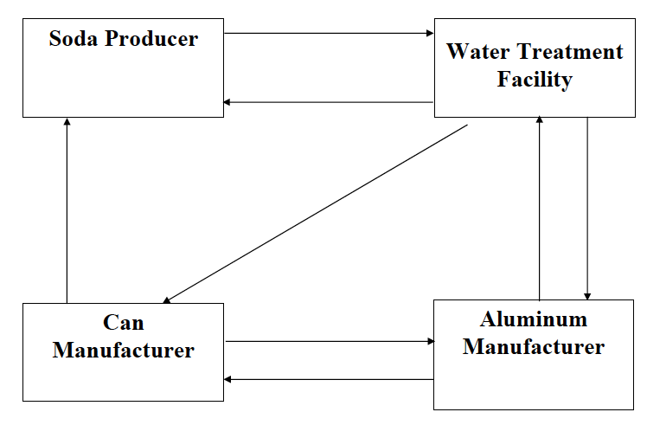
Class exercise
Divide into groups of 4 people per group
Look at our simple economy on the right
One person is soda producer, another is water treatment facility, another is can manufacturer and the fourth is aluminum manufacturer
Notes:
Soda manufacturer is supplied by the can manufacturer and in turn supplies to the water treatment facility and also receives water from the facility to manufacture soda. The water treatment facility also supplies to the can and aluminum manufacturer. The aluminum manufacturer supplies to the water treatment facility and also to the can manufacturer who also supplies to the aluminum manufacturer. Confusing! Now let’s add some numbers to the mix to see who supplies what

Slide 10
Unit Process for Soda Producer
1 gallon (128 ounces) water
10 empty cans
Soda Producer
10 cans of soda

Slide 11
Unit Process for Can Manufacturer
5 gallons water
1 pound aluminum
Interpretation: need 5 gals water for every 1,000 empty cans and 1 pound Al for every 32 cans (find ratio for each per-can!)
Can Manufacturer
1,000 empty cans
32 empty cans

Slide 12
Unit Process for Aluminum
1 empty can*
1.58 gallons water
Aluminum Manufacturer
*scrap material equal
to the material for
one can
1 pound aluminum
2 pounds aluminum

Slide 13
Unit Process for Treated Water
5 pounds of aluminum
5 cans of soda
Water Treatment Plant
1,000 gallons water
10,000 gallons water

Slide 14
Production functions of our simple economy (normalized)
Soda Producer
To make 1 can of soda: 0.1 gallon water AND
For 1 can of soda: 1 empty can
Can Manufacturer
For 1 empty cans: 0.032 pound aluminum AND
For 1 empty cans: 0.005 gallons water
Aluminum Manufacturer
For 1 pound aluminum: 1.58 gallons water AND
For 1 pounds aluminum: 0.5 empty can
Water Treatment Plant
For 1 gallons of water: 0.005 pounds aluminum AND
For 1 gallons of water: 0.0005 cans of soda

Slide 15
Goal of Class Exercise
Goal: to see how much of every industry’s product it takes to make 1,000,000 cans of soda
Place and receive “purchase orders”
The first order (1M cans of soda) comes from me.
That order will initiate other orders to meet the first order
This repeats itself….
Stopping/Cut-off rule: when unit needed is <1 (i.e., do not place an order if the amount you would order is less than 1 unit of what they produce)
Where units = cans, pounds, gallons
Notes:
The goal of this exercise is to make 1,000,00 cans of soda. You are provided with purchase order slips, a table to note down purchase orders received, and the production functions. Calculate and trade with groups based on what you need to produce 1,000,000 cans of soda.

Slide 16
Goal of Class Exercise
Each member will be an industrial sector
Each sector will take purchase orders and then make purchase orders required to fulfill the purchase orders they received (Use the production functions)
At the end, sum up all of the purchase orders received to arrive at amounts of each material needed to make 1,000,000 cans of soda
Notes:
The goal of this exercise is to make 1,000,00 cans of soda. You are provided with purchase order slips, a table to note down purchase orders received, and the production functions. Calculate and trade with groups based on what you need to produce 1,000,000 cans of soda.

Slide 17
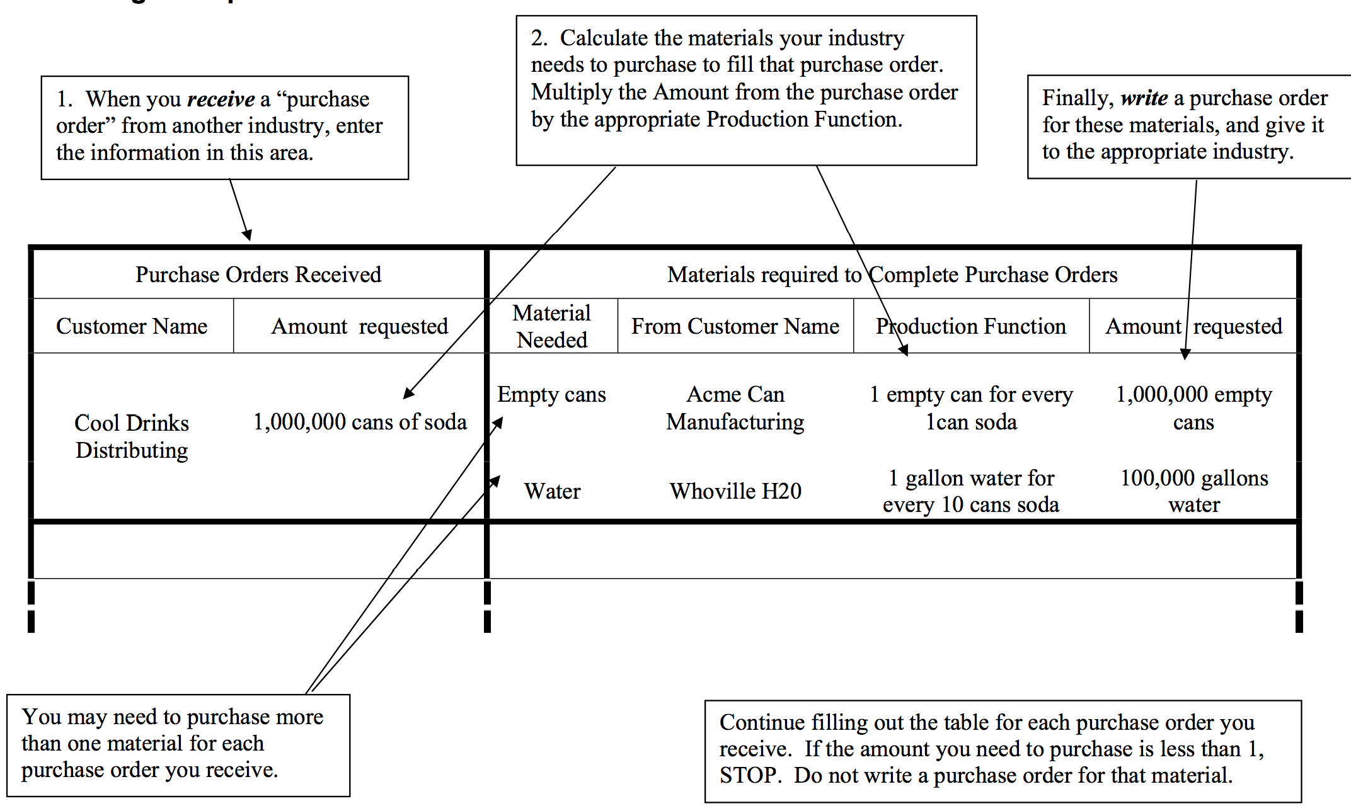
Log Sheet Provided

Slide 18
Overall Info Needed
Group | Total Soda Cans | Total Empty Cans | Total Gallons Water | Total Pounds Aluminum
Avg:

Slide 19
Assume a group estimated production below. Using previous emissions factors, what are total emissions?
 | Production | Wastewater per unit | Solid Waste per unit | Wastewater | Solid Waste
Soda | 1,000,078 cans | 8 ounces per 10 cans soda | 1 pound for every 100 cans
Can | 1,016,039 empty cans | 5 gallons per 1000 empty can | N/A
Aluminum | 32,525 pounds | 1.58 gals per pound Aluminum | 2.7 pounds per pound Aluminum
Water | 156,475 gallons | N/A | 1 pound per 1000 gallons
Notes:
ANSWER SLIDE – DO NOT POST BEFORE LECTURE
Wastewater Solid Waste
Soda 6250 10,001
Can 5,082 0
Aluminum 51,389 87,816
Water 0 156
Total 62,721 97,974

Slide 20
Economic Input-Output Analysis
Originally developed by Wassily Leontief
Models represented the various inputs required to produce a unit of output in each economic sector
Assembling all the sectors, trace all direct and indirect inputs to produce outputs in each sector
Quantifies relationships between sectors of an economic system
Useful to track economic dependencies among sectors
Example sectors: iron steel mills, paper mills, timber producers, trucking and courier services, banking, wholesale trade

Slide 21
Input-Output method
Input-output model divides entire economy into distinct sectors
Set of large tables or matrices with 480 rows and 480 columns
Each sector represented by one row and one column
Economic input-output model is linear. That means a $100 purchase from a sector would be ten times greater than a $10 purchase from same sector
If you buy 1 kg of a product from a sector for $10 then buying 10 kg would cost $100

Slide 22
Example
Demand from households, government, export. Can also be explained as demand of goods not used to produce other goods
Sectors of our economy purchasing and producing our stuff
Processing Sectors | Purchasing Sectors |  |  | Final Demand | Total Output
 | Agriculture | Forest Products | Manufacturing
Agriculture Forest Products Manufacturing | 8 7 4 | 4 9 2 | 4 5 4 | 20 11 24 | 36 32 34
Value Added Imports | 11 6 | 15 2 | 13 8 |  | 39 16
Total Outlay | 36 | 32 | 34 | 55 | 157
Value added is income earned in production including labor earnings
Eg- compensation, taxes
Transactions Table forms the basis for the I-O Model
Source: Eric McConnell 2014 presentation

Slide 23
Data Sources in EIO-LCA (1997)

Slide 24
Life Cycle Stages: tracking energy and emissions
At each stage, there are some inputs used and some outputs created that need to be identified
Example: automobile production
Direct: emissions from factory boilers
Indirect: emissions from suppliers’ factories, electricity purchased by assembly factory, etc

Slide 25
Effects Specified
Direct
Inputs needed for final production of product (energy, water, etc.)
Indirect
ALL inputs needed in supply chain
e.g. Metal, belts, wiring for engine
e.g. Copper, plastic to produce wires
Calculation yields every $ input needed

Slide 26
Example of using EIO-LCA
As defined by US Department of Commerce, The Vehicle and other Transportation Equipment Industry contains the Automobile manufacturing sector
We will trace through production of $1 million of automobiles manufactured in 2002.
First I go to www.eiolca.net

Slide 27

EIOLCA tool

Slide 28

Steps to use EIO-LCA

Slide 29
Total economic output of $1 million automobile manufacturing
Sector | Total Economic | Total Value Added | Employee Comp VA | Net Tax VA | Profits VA | Direct Economic | Direct Economic
 | $mill ↑ | $mill | $mill | $mill | $mill | $mill | %
Total for all sectors | 2.71 | 0.971 | 0.56 | 0.042 | 0.368 | 1.74 | 64.2
Automobile Manufacturing | 0.849 | 0.21 | 0.073 | 0.002 | 0.135 | 0.849 | 100
Motor vehicle parts manufacturing | 0.506 | 0.15 | 0.114 | 0.003 | 0.033 | 0.446 | 88.1
Light Truck and Utility Vehicle Manufacturing | 0.15 | 0.031 | 0.013 | 0 | 0.018 | 0.15 | 99.9
Wholesale trade | 0.124 | 0.086 | 0.047 | 0.02 | 0.019 | 0.057 | 46.1
Management of companies and enterprises | 0.108 | 0.067 | 0.056 | 0.002 | 0.009 | 0.033 | 30.9
Iron and steel mills | 0.038 | 0.01 | 0.008 | 0 | 0.003 | 0 | 1.6
Semiconductor and related device manufacturing | 0.026 | 0.012 | 0.005 | 0 | 0.007 | 0.014 | 54.7
Truck transportation | 0.025 | 0.011 | 0.008 | 0 | 0.003 | 0.009 | 34.2
Other plastics product manufacturing | 0.021 | 0.008 | 0.006 | 0 | 0.002 | 0.01 | 48.5
Power generation and supply | 0.02 | 0.014 | 0.004 | 0.002 | 0.007 | 0.002 | 10.7
Need cars to make cars
Service sectors also represented
Top 10 sectors only presented here

Slide 30
Definitions of economic output headline
Total economic- the complete economic supply chain of purchases (direct and indirect) needed to produce the level of output required (in this case $1million automobiles manufacturing)
Total value added (VA) by sector- represents the difference between output and supply chain purchases. Value added includes interests, rents, royalties, dividends, profit payments, excise and sales tax
Direct economic effects- purchases made by the industry being analyzed (in this case automobile manufacturing)

Slide 31
Value Added Components
Employee Compensation- the portion of value added in the form of employee compensation or labor costs
Net tax- This represents taxes paid minus any subsidies received
Profits- This represents value added in form of profits

Slide 32
Total conventional air pollutants output of $1 million automobile manufacturing
A lot of iron and steel required for automobiles
Sector | CO | NH3 | NOx | PM10 | PM2.5 | SO2 | VOC
 | t | t | t | t | t | t | t
Total for all sectors | 2.52 | 0.119 | 1.46 | 0.478 | 0.196 | 1.47 | 0.757
Iron and steel mills | 0.538 | 0.002 | 0.081 | 0.022 | 0.018 | 0.06 | 0.018
Alumina refining and primary aluminum production | 0.29 | 0 | 0.013 | 0.009 | 0.006 | 0.092 | 0.004
Truck transportation | 0.2 | 0 | 0.211 | 0.06 | 0.011 | 0.004 | 0.022
Motor vehicle parts manufacturing | 0.178 | 0.001 | 0.032 | 0.007 | 0.005 | 0.017 | 0.047
Carbon black manufacturing | 0.124 | 0 | 0.01 | 0.002 | 0.001 | 0.066 | 0.003
Natural gas distribution | 0.083 | 0 | 0.004 | 0 | 0 | 0.001 | 0.004
Iron, steel pipe and tube manufacturing from purchased steel | 0.077 | 0 | 0.011 | 0.004 | 0.003 | 0.009 | 0.005
Commercial and industrial machinery and equipment rental and leasing | 0.067 | 0 | 0.001 | 0 | 0 | 0 | 0.005
Wholesale trade | 0.062 | 0 | 0.061 | 0.017 | 0.003 | 0.004 | 0.033
Household goods repair and maintenance | 0.053 | 0 | 0 | 0 | 0 | 0 | 0.004
Headline represent emissions of CO, NH3, NOx, PM10, PM2.5, SO2, VOC from each sector
Some sectors which would have not shown up in traditional process based LCA results
Top 10 sectors only presented here

Slide 33
Total GHG output of $1 million automobile manufacturing
Sector | Total | CO2 Fossil | CO2 Process | CH4 | N2O | HFC/PFCs
 | t CO2e | t CO2e | t CO2e | t CO2e | t CO2e | t CO2e
Total for all sectors | 563 | 412 | 81.4 | 41.9 | 13 | 14.5
Power generation and supply | 180 | 177 | 0 | 0.488 | 1.1 | 1.14
Iron and steel mills | 108 | 40.7 | 66.5 | 0.657 | 0 | 0
Truck transportation | 24.1 | 24.1 | 0 | 0 | 0 | 0
Oil and gas extraction | 20.4 | 5.75 | 3.74 | 10.9 | 0 | 0
Cattle ranching and farming | 12.4 | 0.815 | 0 | 7.07 | 4.55 | 0
Other basic organic chemical manufacturing | 11.3 | 10.1 | 0 | 0 | 1.16 | 0
Petroleum refineries | 11.1 | 11.1 | 0 | 0.035 | 0 | 0
Motor vehicle parts manufacturing | 10.9 | 10.9 | 0 | 0 | 0 | 0
Automobile Manufacturing | 10.8 | 10.8 | 0 | 0 | 0 | 0
Alumina refining and primary aluminum production | 10.7 | 2.42 | 3.79 | 0 | 0 | 4.46
Most sectors contributing to GHG emissions are intuitive. But some like cattle ranching and farming contributing to total GHG emissions are not intuitive
Top 10 sectors only presented here
Notes:
Sectors contributing to the total outputs can only be understood by an input-output method. But it will be harder to decipher which component of cattle ranching and farming is contributing to automobile manufacturing from the EIOLCA method.

Slide 34
Definition of GHG headers
Total CO2e- the global warming potential is a weighting of GHG emissions into air from production of each sector
CO2 fossil fuel- Emission of CO2 into air from each sector due to fossil fuel combustion
CO2 Process- Emission of CO2 into air from each sector from sources other than fossil fuel combustion
CH4, N2O, HFC/PFC- Emission of CH4, N2O, HFC/PFC into air from each sector

Slide 35
Total energy output of $1 million automobile manufacturing
Sector | Total Energy | Coal | NatGas | Petrol | Bio/Waste | NonFossElec
 | TJ | TJ | TJ | TJ | TJ | TJ
Total for all sectors | 8.33 | 2.56 | 2.63 | 1.29 | 0.435 | 1.41
Power generation and supply | 2.19 | 1.6 | 0.467 | 0.078 | 0 | 0.051
Iron and steel mills | 1.25 | 0.743 | 0.341 | 0.012 | 0.005 | 0.151
Motor vehicle parts manufacturing | 0.46 | 0.005 | 0.19 | 0.014 | 0.024 | 0.228
Automobile Manufacturing | 0.381 | 0.004 | 0.19 | 0.013 | 0.04 | 0.133
Truck transportation | 0.327 | 0 | 0 | 0.324 | 0 | 0.003
Other basic organic chemical manufacturing | 0.259 | 0.032 | 0.099 | 0.036 | 0.078 | 0.014
Petroleum refineries | 0.187 | 0 | 0.05 | 0.121 | 0.009 | 0.007
Alumina refining and primary aluminum production | 0.172 | 0 | 0.046 | 0.001 | 0.004 | 0.12
Plastics material and resin manufacturing | 0.169 | 0.007 | 0.088 | 0.037 | 0.018 | 0.019
Paperboard Mills | 0.161 | 0.015 | 0.033 | 0.007 | 0.095 | 0.011
Headlines represent the total energy used by each sector from coal, natural gas, petrol, biomass/waste and non fossil fuel sources
Top 10 sectors only presented here

Slide 36
Total hazardous waste generated from $1 million automobile manufacturing
Sector | Haz Waste Gen
 | st
Total for all sectors | 416000
Other basic organic chemical manufacturing | 107000
Motor vehicle parts manufacturing | 106000
Iron and steel mills | 49500
Petroleum refineries | 41900
Semiconductor and related device manufacturing | 21400
Plastics material and resin manufacturing | 20400
Automobile Manufacturing | 13400
Wholesale trade | 11200
Coating, engraving, heat treating and allied activities | 7000
Waste management and remediation services | 5820
Some service sectors such as wholesale trade show up in the hazardous waste generation.
Top 10 sectors only presented here

Slide 37
Total toxic releases output of $1 million automobile manufacturing
Sector | Fugitive | Stack | Total Air | Surface Water | U'ground Water | Land | Offiste | POTW Metal | POTW Nonmetal
 | kg | kg | kg | kg | kg | kg | kg | kg | kg
Total for all sectors | 27.7 | 151 | 178 | 25.8 | 22.4 | 357 | 162 | 1.79 | 46.9
Automobile Manufacturing | 4.73 | 44 | 48.7 | 0.009 | 0 | 0.026 | 2.63 | 0.314 | 7.96
Other basic organic chemical manufacturing | 2.52 | 3.97 | 6.48 | 3.02 | 7.64 | 0.14 | 1.01 | 0.035 | 10.7
Motor vehicle parts manufacturing | 1.87 | 9.57 | 11.4 | 0.024 | 0 | 0.375 | 11.2 | 0.364 | 3.34
Iron and steel mills | 1.46 | 1.21 | 2.67 | 11.4 | 0.198 | 10.8 | 77.5 | 0.004 | 0.485
Alumina refining and primary aluminum production | 1.32 | 3.89 | 5.21 | 0.633 | 1.64 | 2.44 | 3.63 | 0.021 | 2.1
Plastics material and resin manufacturing | 1.14 | 2.53 | 3.67 | 0.255 | 1.48 | 0.021 | 0.247 | 0.002 | 2.1
Light Truck and Utility Vehicle Manufacturing | 0.856 | 7.95 | 8.81 | 0.002 | 0 | 0.005 | 0.475 | 0.057 | 1.44
Ferrous metal foundaries | 0.814 | 0.961 | 1.77 | 0.042 | 0 | 3.23 | 10.3 | 0.054 | 0.051
Metal can, box, and other container manufacturing | 0.692 | 1.41 | 2.11 | 0 | 0 | 0 | 0.008 | 0 | 0.011
Synthetic rubber manufacturing | 0.567 | 1.01 | 1.58 | 0.08 | 0.251 | 0 | 0.079 | 0 | 0.023
Top 10 sectors only presented here

Slide 38
Total water withdrawals of $1 million automobile manufacturing
Sector | Water Withdrawals
 | kGal
Total for all sectors | 8900
Power generation and supply | 5120
Paint and coating manufacturing | 868
Cotton farming | 775
Grain farming | 745
Iron and steel mills | 157
Paperboard Mills | 126
Cattle ranching and farming | 115
Gold, silver, and other metal ore mining | 105
Motor vehicle parts manufacturing | 80.8
Other basic organic chemical manufacturing | 78.2
Top 10 sectors only presented here

Slide 39
Total movement of inputs/freight of $1 million automobile manufacturing via various modes
Sector | Air | Oil Pipe | Gas Pipe | Rail | Truck | Water | Intl Air | Intl Water | Total
 | ton-km | ton-km | ton-km | ton-km | ton-km | ton-km | ton-km | ton-km | ton-km
Total for all sectors | 5260 | 53600 | 45300 | 1220000 | 663000 | 96600 | 8230 | 1600000 | 3690000
Leather and hide tanning and finishing | 2730 | 0 | 0 | 45.1 | 5530 | 0 | 738 | 935 | 9980
Automobile Manufacturing | 562 | 0 | 0 | 829000 | 231000 | 445 | 359 | 249000 | 1310000
Motor vehicle parts manufacturing | 467 | 0 | 0 | 103000 | 108000 | 28.6 | 2740 | 111000 | 325000
Other leather and allied product manufacturing | 280 | 0 | 0 | 8.39 | 352 | 0 | 107 | 3260 | 4010
Other basic organic chemical manufacturing | 123 | 0 | 0 | 9720 | 3060 | 2470 | 40.8 | 21000 | 36400
Iron and steel mills | 66.8 | 0 | 0 | 41300 | 51600 | 11100 | 48.4 | 201000 | 305000
Paint and coating manufacturing | 57.5 | 0 | 0 | 1760 | 4940 | 29.5 | 7.25 | 242 | 7040
Semiconductor and related device manufacturing | 48.8 | 0 | 0 | 150 | 629 | 0 | 171 | 68.9 | 1070
Notes:
The highlighted sectors are transported the longest distances via any mode of transportation. Intuitively it makes sense as most automobiles are manufactured in Detroit and transferred around the nation by rail and trucks.

Slide 40
Total land use from all sectors from $1 million automobile manufacturing
Sector | Land Use
 | 1000 x ha (kha)
Total for all sectors | 0.065
Cattle ranching and farming | 0.021
Logging | 0.014
Automobile Manufacturing | 0.01
Forest nurseries, forest products, and timber tracts | 0.01
All other crop farming | 0.002
Grain farming | 0.001
Light Truck and Utility Vehicle Manufacturing | 0.001
Cotton farming | 0.001
Truck transportation | 0
Oilseed farming | 0

Slide 41
TRACI impacts from all sectors from $1 million automobile manufacturing
Sector | Glob Warm | Acidif Air | HH Crit Air | Eutro Air | Eutro Water | OzoneDep | Smog Air | EcoTox (low) | HH Cancer (low) | HH NonCancer (low) | EcoTox (high) | HH Cancer (high) | HH NonCancer (high)
 | kg CO2e | kg SO2e | kg PM10e | kg Ne | kg Ne | kg CFC-11e | kg O3e | kg 2,4D | kg benzene eq | kg toluene eq | kg 2,4D | kg benzene eq | kg toluene eq
Total for all sectors | 569000 | 2880 | 892 | 79 | 0.305 | 0.562 | 39200 | 50.9 | 106 | 76200 | 52.9 | 707 | 1090000
Power generation and supply | 180000 | 1030 | 205 | 15.1 | 0.003 | 0 | 8310 | 2.09 | 3.06 | 1720 | 2.1 | 9.16 | 9060
Iron and steel mills | 108000 | 127 | 46.5 | 3.75 | 0.058 | 0 | 2090 | 1.41 | 11.3 | 12500 | 1.66 | 12.4 | 13300
Truck transportation | 24100 | 172 | 73.8 | 9.42 | 0 | 0 | 5330 | 0 | 0 | 0 | 0 | 0 | 0
Oil and gas extraction | 20400 | 32.3 | 1.97 | 1.67 | 0 | 0 | 1130 | 0 | 0 | 0 | 0 | 0 | 0
Cattle ranching and farming | 12400 | 81.8 | 15 | 5.08 | 0 | 0 | 62.4 | 0 | 0 | 0 | 0 | 0 | 0
Other basic organic chemical manufacturing | 12100 | 44.6 | 9.21 | 1.26 | 0.044 | 0.088 | 715 | 0.058 | 1.02 | 127 | 0.199 | 4.72 | 312
Motor vehicle parts manufacturing | 11600 | 44.2 | 14 | 1.54 | 0 | 0.026 | 968 | 4.45 | 2.14 | 1680 | 4.59 | 7.44 | 16300
Petroleum refineries | 11200 | 26.7 | 5.58 | 0.493 | 0.009 | 0.001 | 282 | 0.028 | 0.309 | 74.2 | 0.038 | 0.84 | 89.1
Automobile Manufacturing | 10800 | 38 | 11.4 | 1.23 | 0 | 0 | 1490 | 0.202 | 0.53 | 75.9 | 0.207 | 6.37 | 161
Alumina refining and primary aluminum production | 10700 | 105 | 28.8 | 0.629 | 0.013 | 0.12 | 341 | 0.137 | 0.934 | 311 | 0.151 | 19.6 | 11900
Notes:
These are impacts from the economy due to $1million automobile manufacturing. Since EIOLCA is linear, the impacts for $10 million automobile manufacturing would be 10 times higher. But if I am an automobile manufacturer and I look at my impact as not as high as power generation or iron and steel mills. It is difficult to suggest process improvements based off the results obtained here.

Slide 42
Necessity of EIO-LCA
Process-based LCA are time consuming
EIO-LCA may be used as a quick approximation tool
Hypothesis- each $ of production or TJ of product uses the same amount of energy and resources and results in the same pollution discharge
Sector | Computers | Automobiles | Shoes
Air pollutants per $1M (metric tons) | 6.2 | 15 | 13
Air pollutants per TJ of petroleum (metric tons) | 4.0 | 4.3 | 4.0
Toxic discharges per $1M (metric tons) | 32 | 2.0 | 1.1
Toxic discharges per TJ of petroleum (metric tons) | 2.1 | 0.59 | 3.5
Source: Modified from Hendrickson et al (2006)
Large ranges across sectors. Service sectors cannot be estimated by this. The approximations are not a good replacement for a thorough life cycle assessment. However, it is a quick and easy tool to understand some of the underlying life cycle impacts

Slide 43
Class Activity
www.eiolca.net
Visit website and select an industry-
Eg- Agriculture, livestock, fisheries and farming is an industry
Oilseed farming is a sector under this industry. It is an aggregate sector and includes sectors for soybean farming and oilseeds except soybean farming
Select economic activity of 1 million dollars for this sector
Select economic activity as category of results to display and run the model

Slide 44
Class Activity
What are the top 10 sectors contributing to the $1M economic activity?
Change display of results to conventional air pollutants. What are the top 10 sectors now?
Do the sectors remain the same when you change the results to greenhouse gases, water withdrawals, transportation?
Are there any sectors that are consistent when the display results are changed?
What should the Oilseed sector do if they set a goal to reduce GHG emissions?
Now compare and contrast results with selecting another sector “Grain Farming” within the Agriculture, livestock, fisheries and farming industry

Slide 45
Summary
Process based LCA
Unit process
Economic Input Output life cycle assessment
Circularity
Purchasing Sectors
Processing Sectors
Production Functions
Final demand
Value added
Direct economic effects
Employee Compensation
CO2 from fossil fuels
TRACI Impacts

